Slide 1
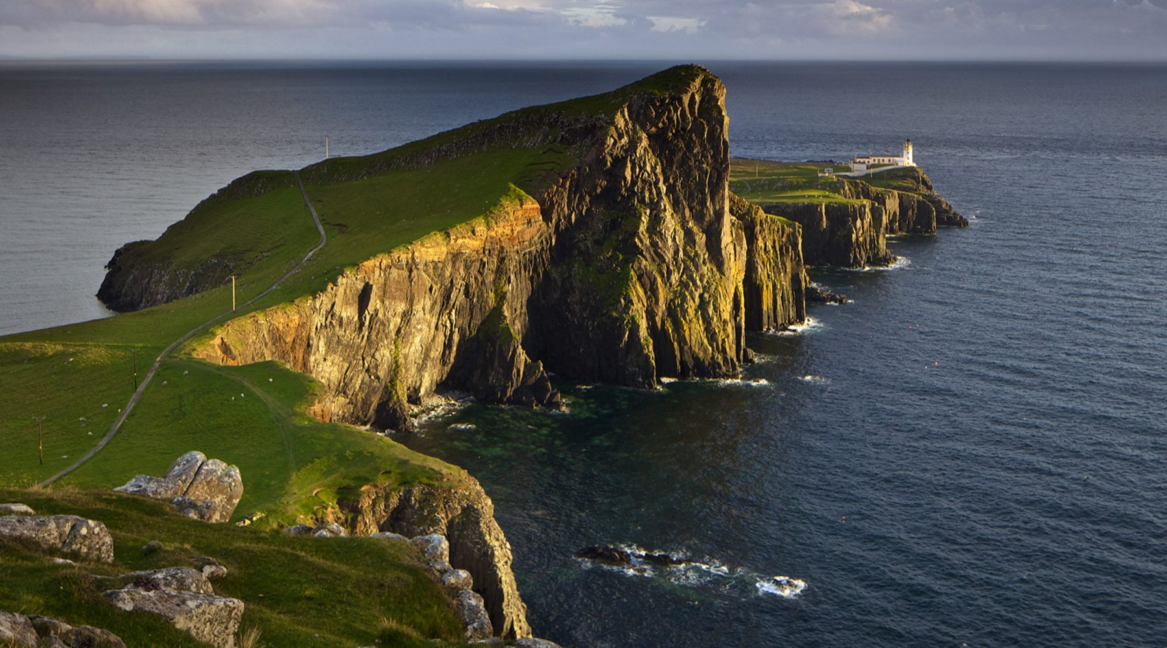
The effect of Covid-19 on International Tourism in Scotland

Slide 2
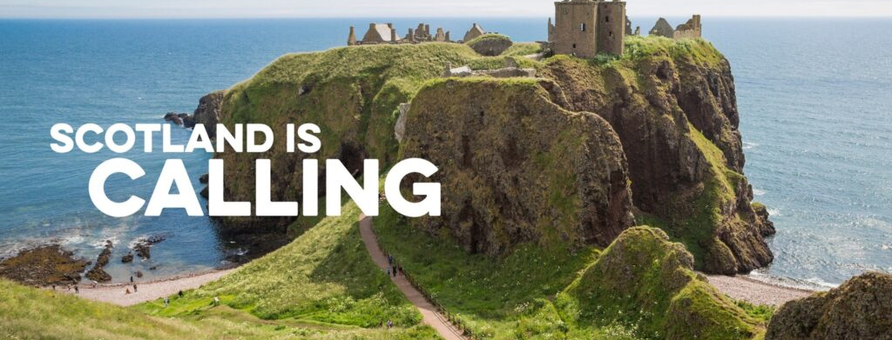

National tourism organisation for Scotland
Works with businesses to increase tourism revenue and provide support
Informs tourists on getting the most from their trip to Scotland
Notes:
Visit Scotland" is the national tourism organization responsible for promoting Scotland as a tourist destination and attracting visitors from around the world. It is a public agency funded by the Scottish Government.
Visit Scotland's primary role is to market and showcase Scotland's diverse attractions, landscapes, heritage, culture, and events to potential visitors. They aim to increase tourism revenue and support local businesses and communities across the country. Their activities include advertising campaigns, digital marketing, travel trade engagement, public relations, and partnerships with various stakeholders.

Slide 3
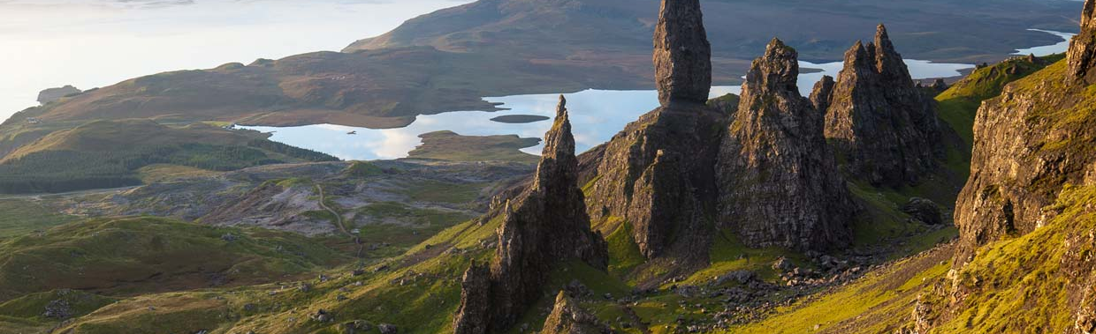

The Brief
How has international tourism in Scotland recovered post covid 19?
KPI’s
- Number of Visitors
- The amount of money generated from international tourism

Slide 4
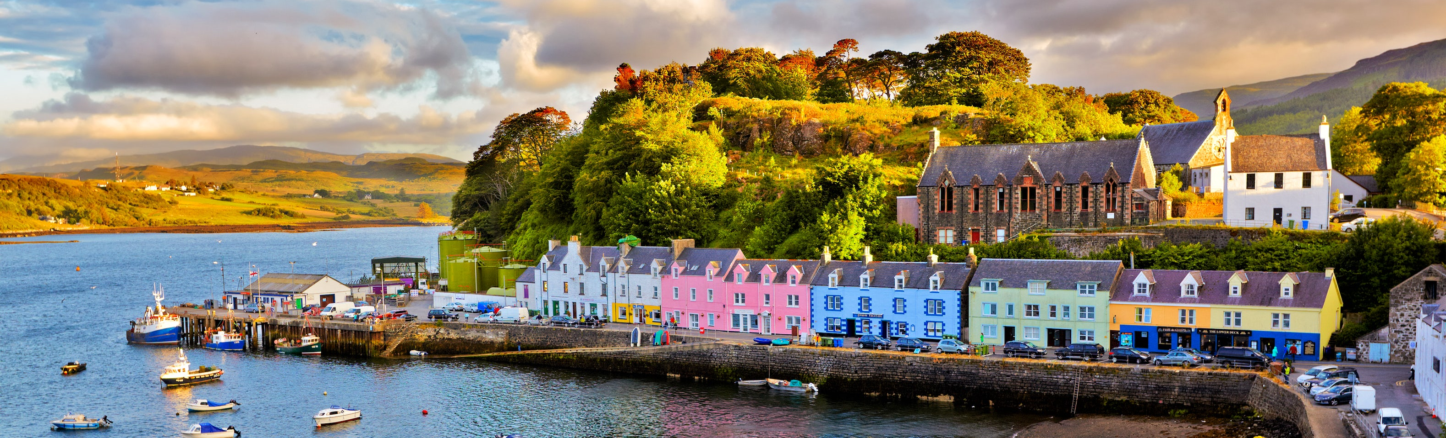
About the data
Data from ONS (Overseasresidentsvisitstotheuk2018to2022)
Ethical considerations
Notes:
Ethical Considerations.

Slide 5
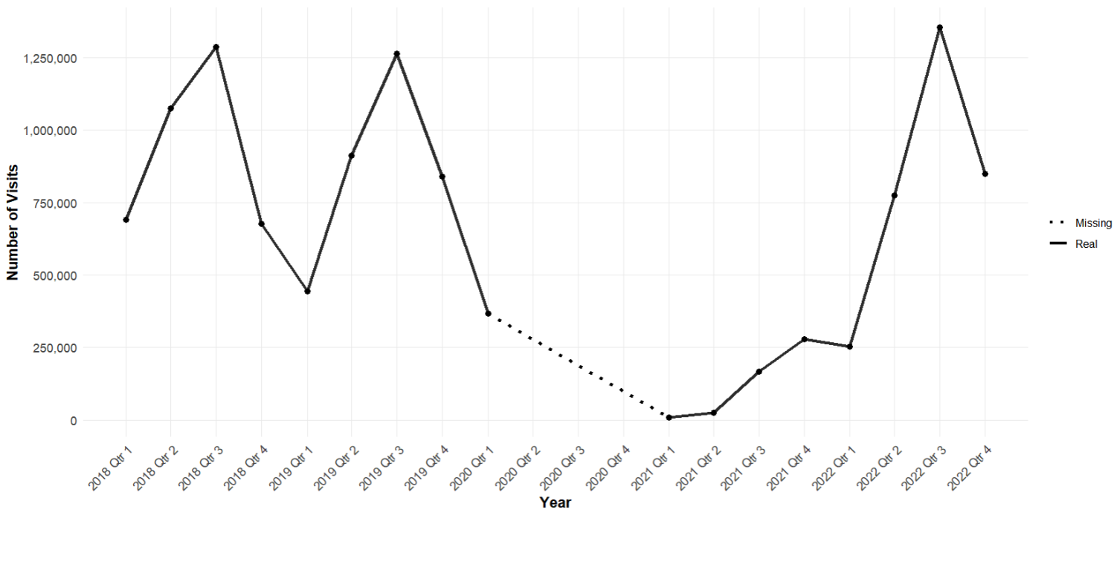


Annual Number of Visits to Scotland
Trend: More visitors in Q3 for summer
Overall year figures down compared to pre-pandemic levels
Notes:
Number of Visits follows a pattern Q3 (Jul/Aug/Sep) peak
Pre lockdown numbers remain steady, slight decline in 2019
After 2020 Q1 Lockdown (no data for rest of 2020)
Sharp increase in 2022 Q3 (Highest since 2018)

Slide 6
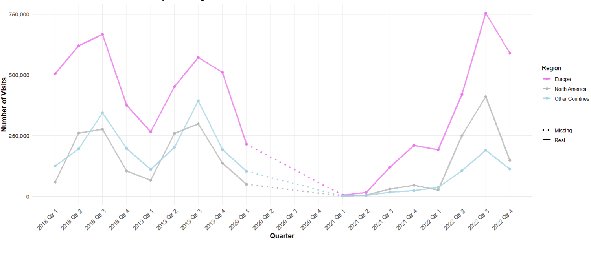

Annual Number of Visits to Scotland per Region
Most visitors to Scotland are from Europe
Top 5 UK Visitors:
USA
France
Republic of Ireland
Germany
Spain
Notes:
Europe remains the biggest source for visitors in Scotland
Post Lockdown North America has overtaken the “Other Countries Demographic”
Top 5 countries UK Visits
1)USA
2)France
3) Republic of Ireland
4) Germany
5) Spain

Slide 7
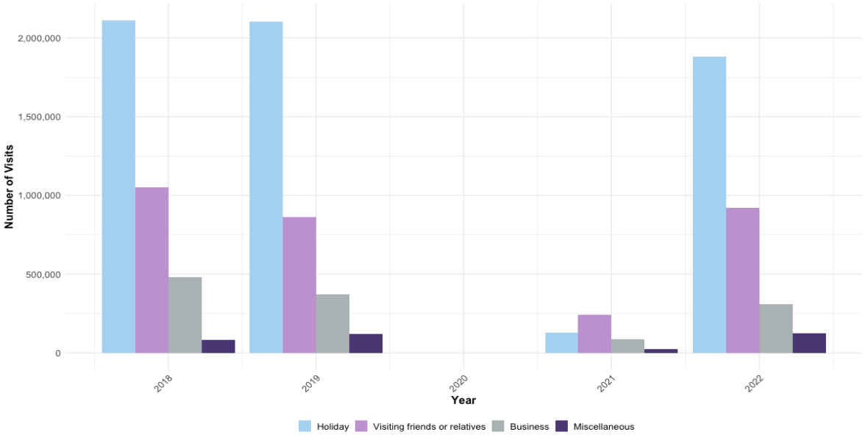
Number of Visits to Scotland by Purpose
The main reason people visit Scotland is for Holidaying
Spike in visiting friends and family post-pandemic
Business least effected
Notes:
The main demographic for Scotland's Tourism is Holiday makers.
Although there is a slight decrease from 2018/2019 Scotland looks on track to return to pre pandemic levels
Interestingly in 2021 the number one reason for people visiting in 2021 was to visit friends and family
Buisness trips was the least effectected by the pandemic

Slide 8
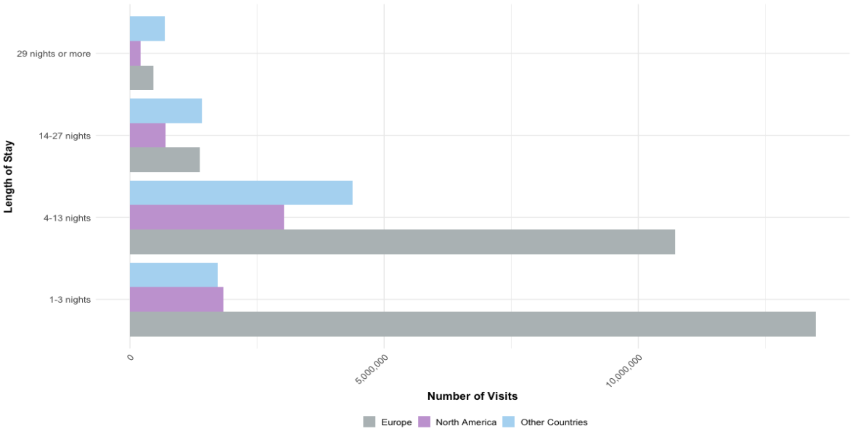
Average Length of Stay
Europeans typically stay under two weeks
Americans and other countries tend to stay longer
In 2022, visitors stayed 29.7m nights, up 2m on 2019
Notes:
The majority of visitors travel by air
Numbers have not returned to pre pandemic levels
9% increase in number of nights stayed in 2022 compared to 2019 – with visitors staying 29.7m nights in 2022.

Slide 9
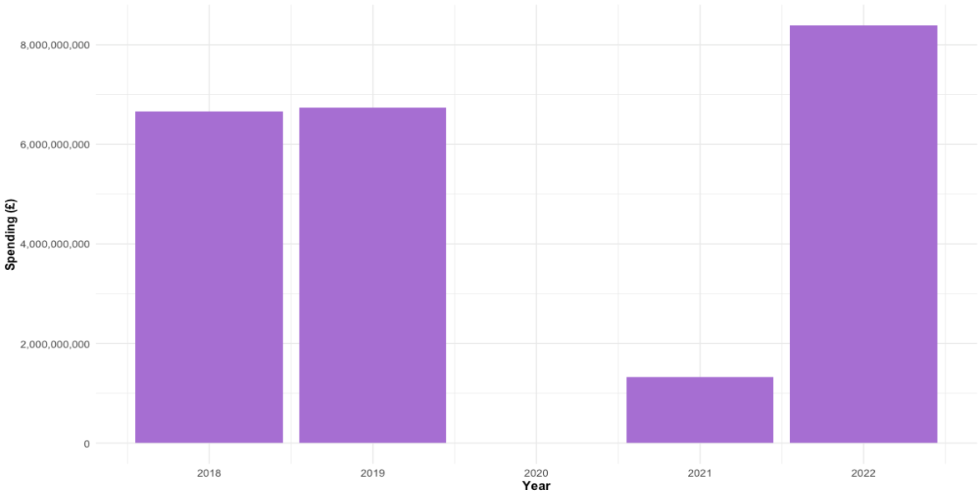


Annual Spending in Scotland
Approx. £6.7bn generated in international tourism in 2019, this rose to £8.3bn in 2022
Notes:
2018 £6,668,013,648 (6.66billion aprrox) 2019 £6,740,408,088 (6.7 billion_
2020 £1,329,873,364 2022 £8,387,069,887 (Just under 8.4Bn)

Slide 10
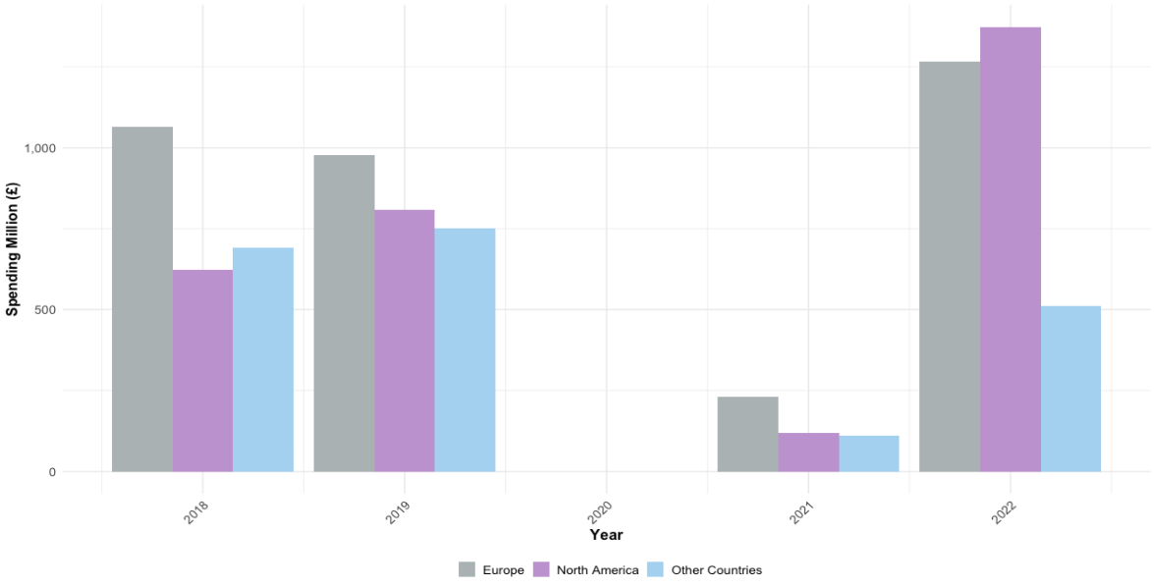
Spending in Scotland by Region
Pre-pandemic, European visitors spent most per visit
Post-pandemic, American tourists spending more
Decline of the pound could account for this
Notes:
Until last year visors in Europe spent the most money.
In 2021, North America overtook “Other Countries”
In 2022 North America became the biggest spenders. Perhaps this is due to the decline of the pound?
When compared to the number of victors you can see that the proportion of spending is a lot closer together which suggests that although Europe generates the most money

Slide 11
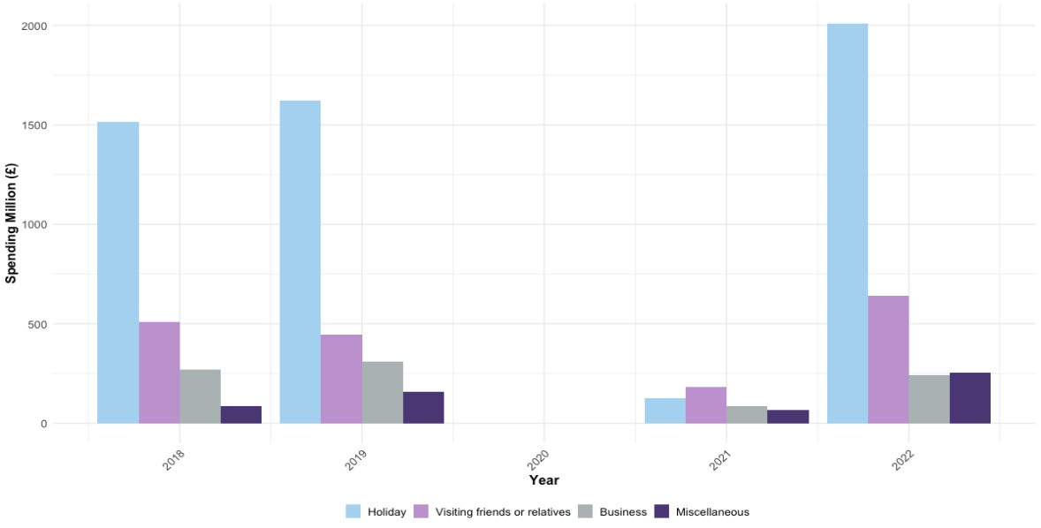

Spending in Scotland by Purpose
Like the number of visits, holidaymakers generate the most income
Average international visitor to Scotland spent £972 over a 9.2 day trip
Notes:
Holiday makers spend the most

Slide 12
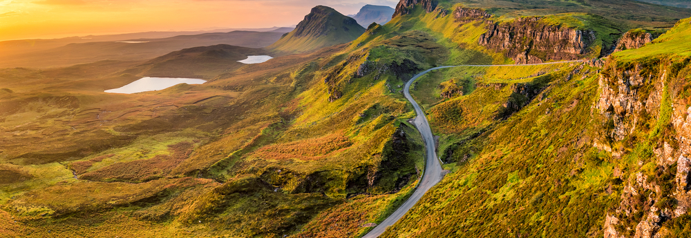
Recommendations and Insights
Post Covid Insights:
Spending increase
Number of Visitors increase
American tourists are most popular, and spend the most
Recommendations:
Data to allow for forecasting
More marketing targeted to American audience
Notes:
Insights to the data suggest that there is a trend in visitors coming to Scotland for Q3, summer.
The most visitors coming to Scotland are from the European region, with America tourists following – more data is needed to confidently identify other countinents as well as those two
People are most likely to visit Scotland for a holiday, and business travel has been least affected by the Covid pandemic
Spending in Scotland is increasing, with annual spending in 2022 nearly £2bn more than pre-pandemic, and tourists from America are spending the most compared to other regions
Holidaymakers are spending the most per trip, nearly three times as much as those visiting friends or family
My recommendations from this study are:
Increase targeted marketing to America, as they are the cohort more likely to spend more in Scotland
Educate the Visit Scotland partners to understand the findings from this study, and to allow partners to have more insight in to this data
For data:
Have more granularity of data – the data only showed data for America, Europe, and then rest of world. It would be more insightful to provide more in-depth detail on where tourists are coming from
Furthermore, gather more data on where tourists are going to in Scotland to better inform Partners and council boards on the demographic of visitors to tailor their services and marketing
Gather more data from online and social media to better inform the strategy, branding and promotion of Visit Scotland

